Slide 1









ROV’25
Remotely Operated Vehicle

Slide 2






Welcome Back

Slide 3







TABLE OF CONTENTS
01.
Relay
03.
ESC
02.
Transistor
04.
T100 & T200

Slide 4






01.
Relay

Slide 5





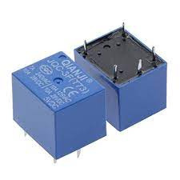





Relay
Relay is a switch which controls (open and close) circuits electromechanically. The main operation of this device is to make or break contact with the help of a signal without any human involvement in order to switch it ON or OFF. An Electromagnet plays a major role in the working of a relay. It is a metal which doesn’t have magnetic property but it can be converted into a magnet with the help of an electrical signal. We know that when current passes through the conductor it acquires the properties of a magnet. So, when a metal winded with a copper wire and driven by the sufficient power supply, that metal can act as a magnet and can attract the metals within its range. It is mainly used to control a high powered circuit using a low power signal. Generally a DC signal is used to control circuit which is driven by high voltage like controlling AC home appliances with dc signals from microcontrollers.

Slide 6
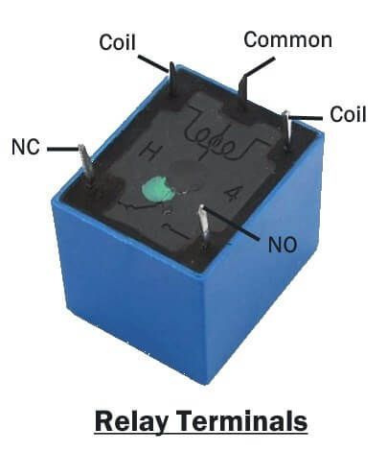

Slide 7
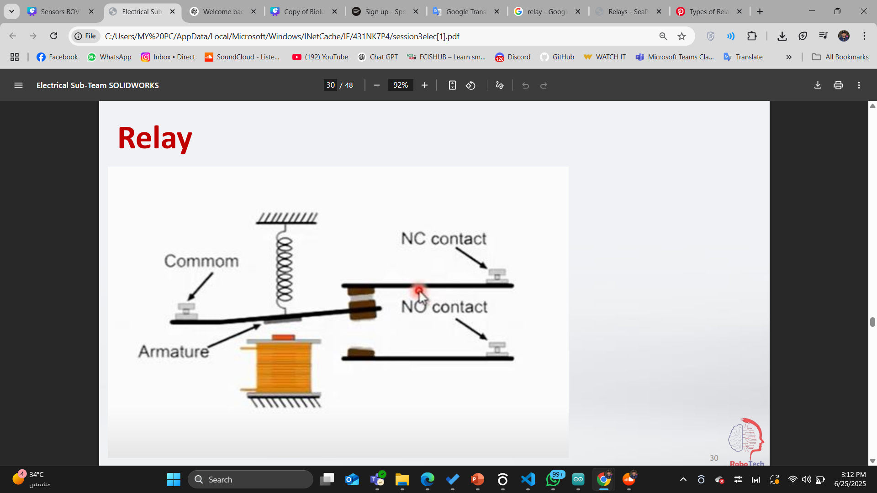
Relay

Slide 8

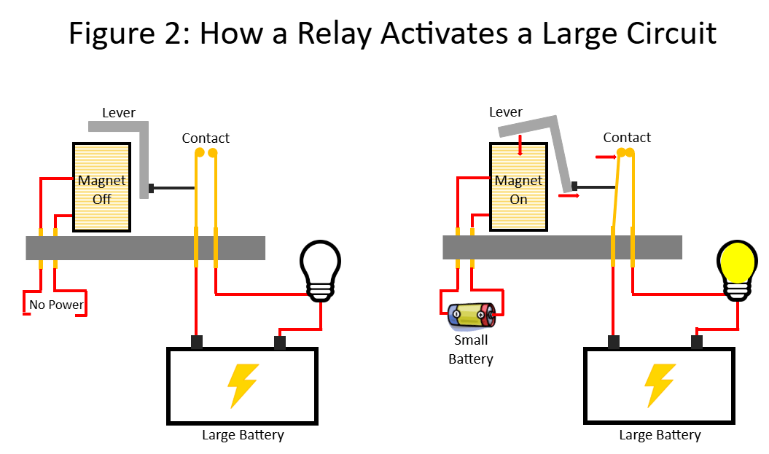




Slide 9




Relay VS Relay Module

Slide 10
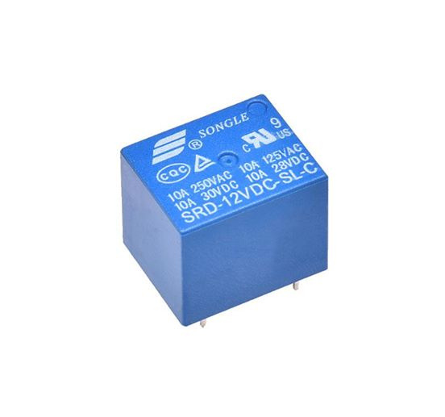
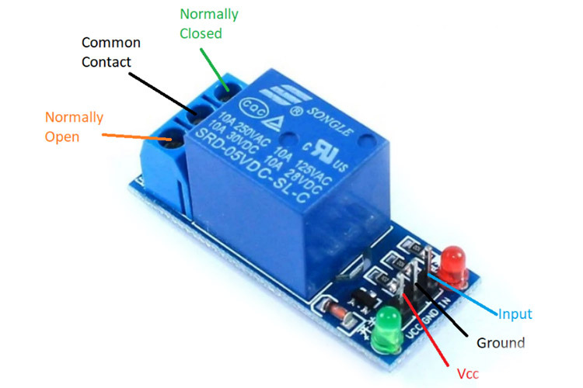
Relay
Relay Module
VS
Electrical Component
Can’t control to arduino eslay .
very sheep (5LE).
Electrical Component
Control to arduino eslay .
expansive (35LE ~ 50 LE).

Slide 11

Relay Module
It’s like Relay but we can connect to arduino by 3 pin
VCC to 5 v
GND to GND
Input to digital pin

Slide 12

Relay Module

Slide 13

How we can code it?

Slide 14
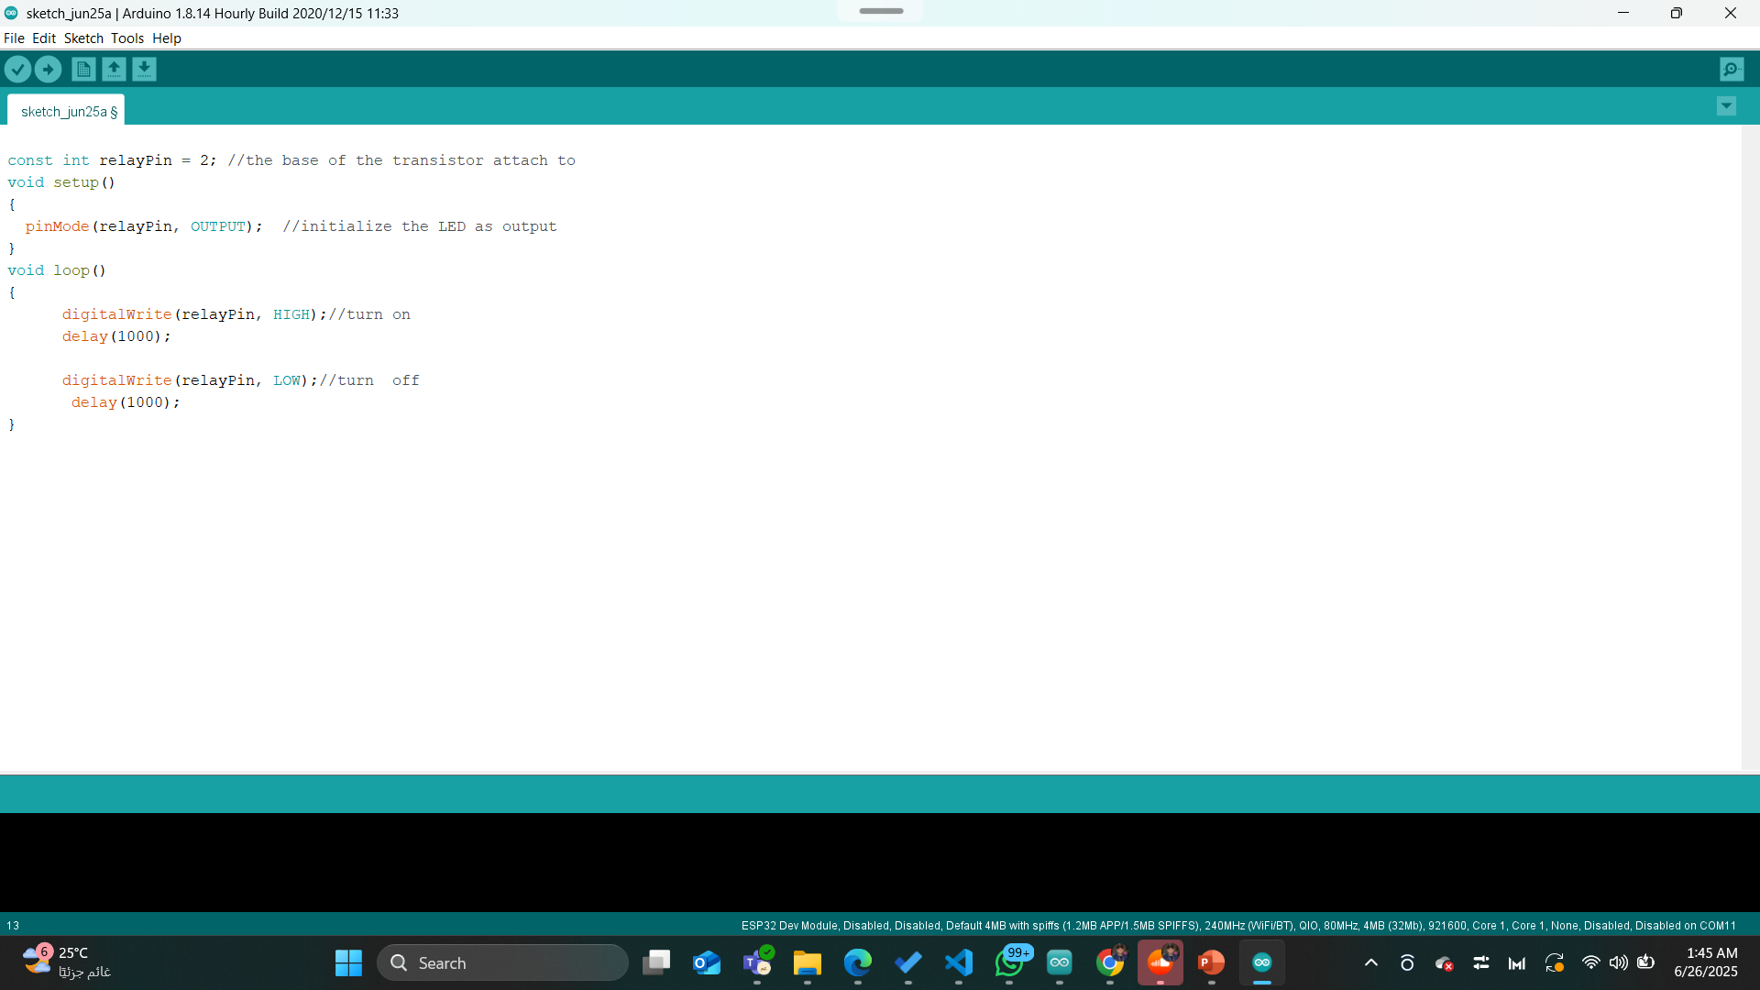
Relay Module

Slide 15
TASK 1!

Slide 16
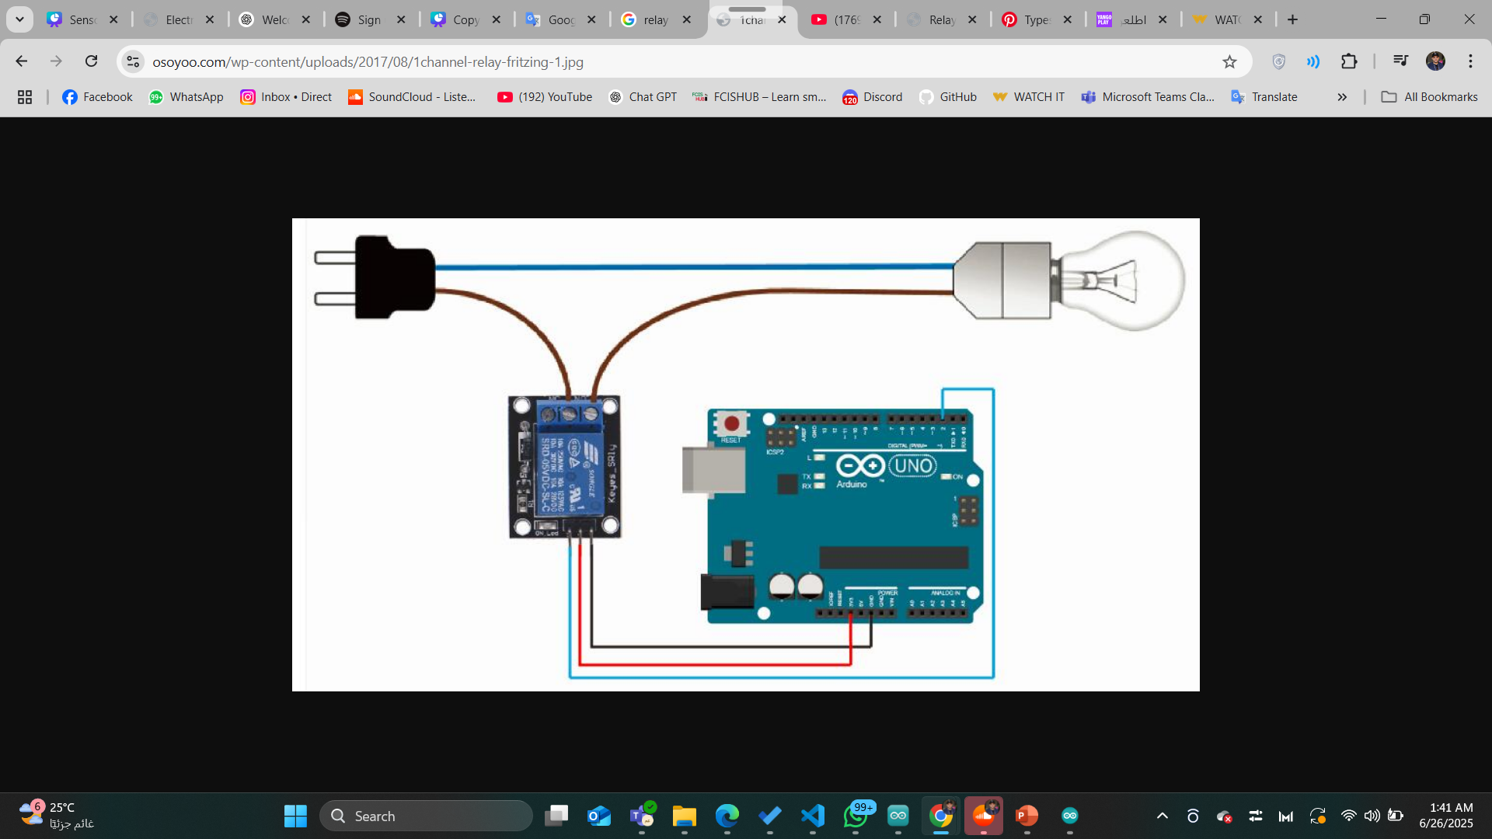
TASK 1

Slide 17
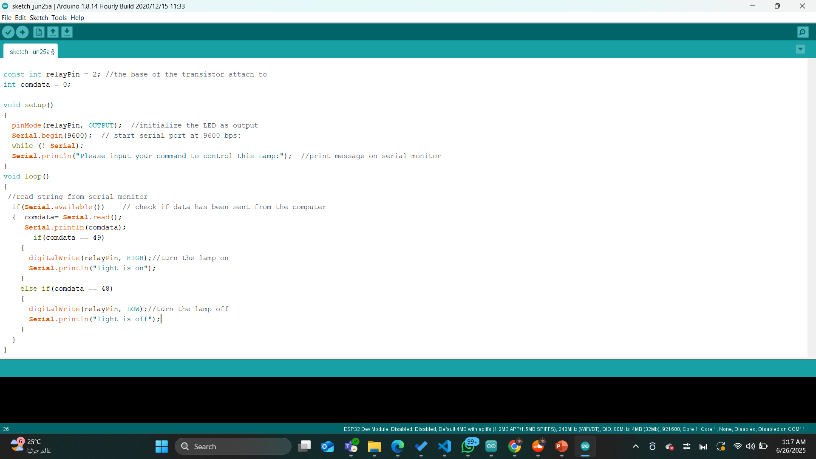
Relay Module

Slide 18
02.
Transistor

Slide 19
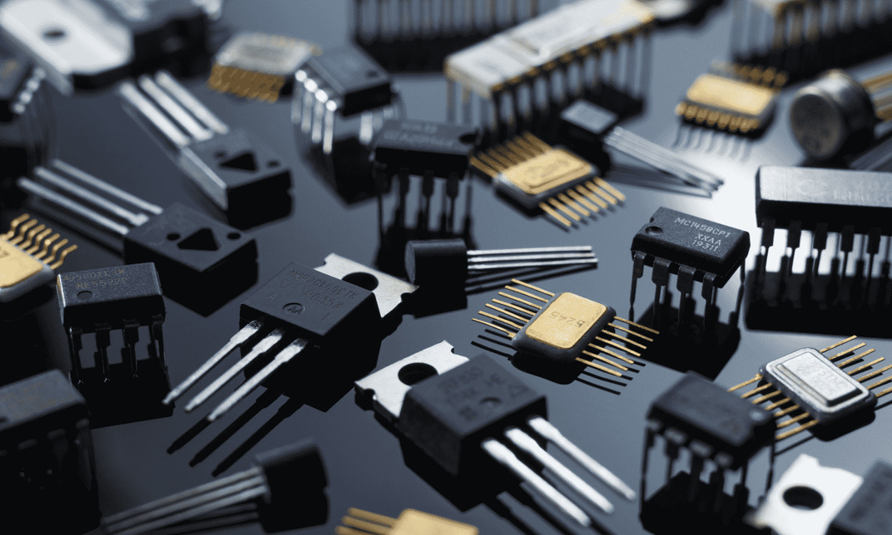
Transistor
The transistor is a 3-terminal semiconductor device that can both conduct and insulate. A transistor can act as a electric switch and an amplifier. It is the fundamental building block of modern electronic devices and found everywhere in modern electronic systems. It is used in many applications such as logic gates, motor drivers, power supplies, driving home applications and many other applications.

Slide 20
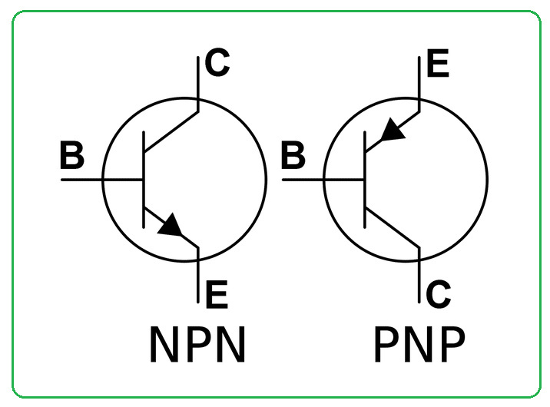
Transistor
BJT
Bipolar Junction Transistor
is a 3-terminal device made from different semiconductor materials that can act as either an insulator or a conductor by the application of a small signal voltage.

Slide 21
03.
ESC

Slide 22
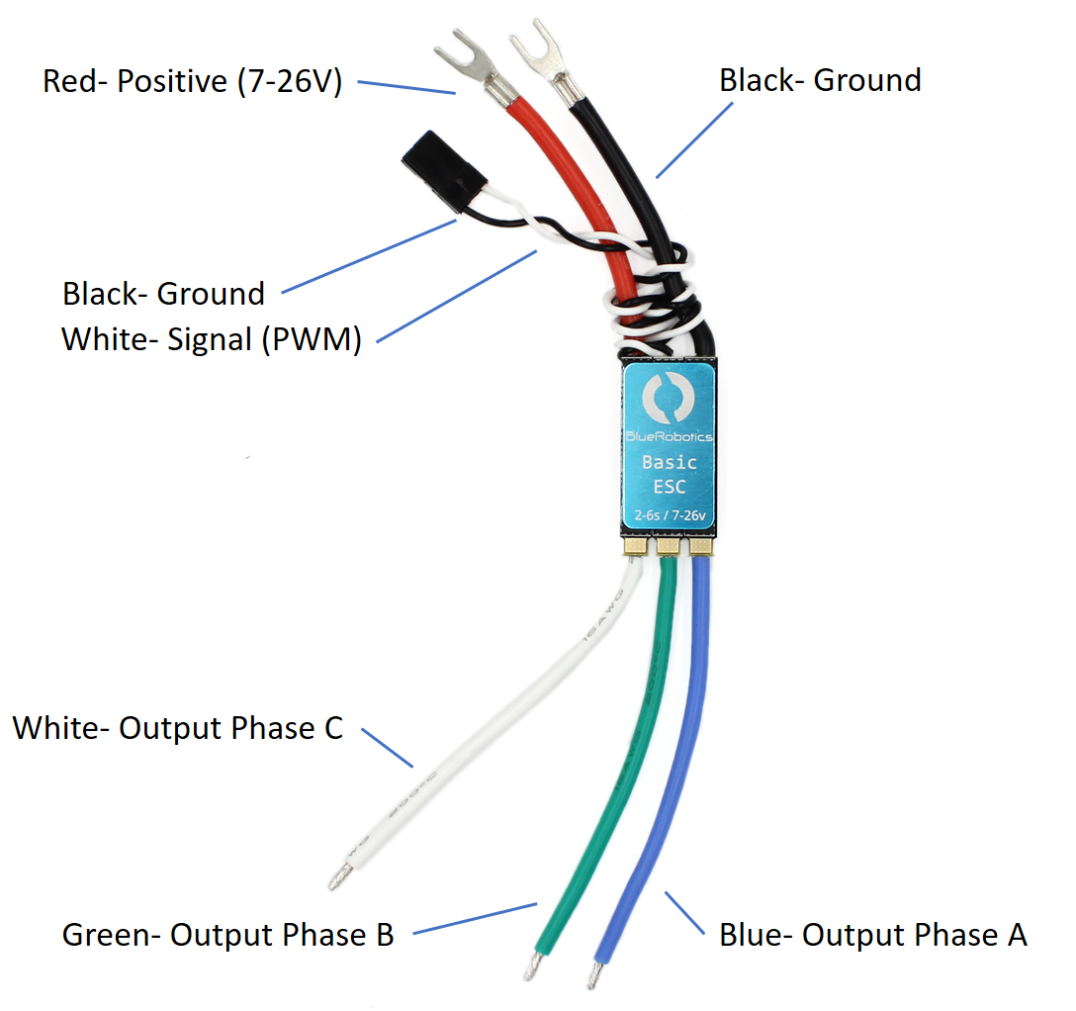
ESC

Slide 23
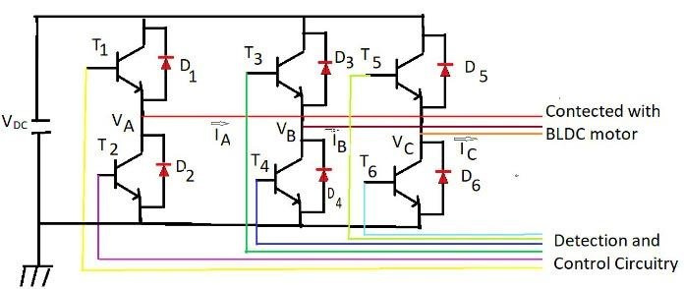
ESC

Slide 24
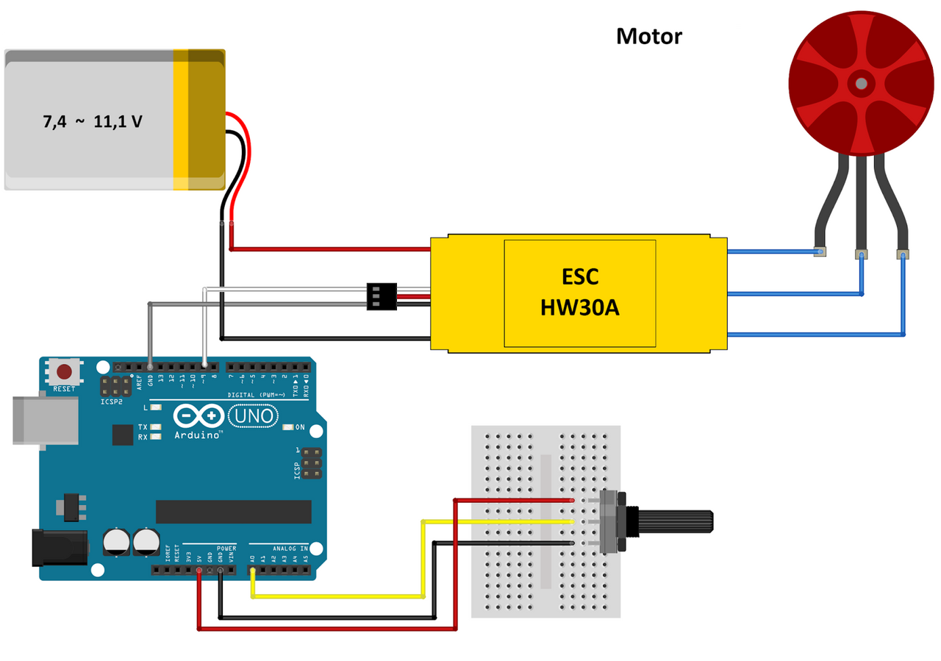
ESC

Slide 25
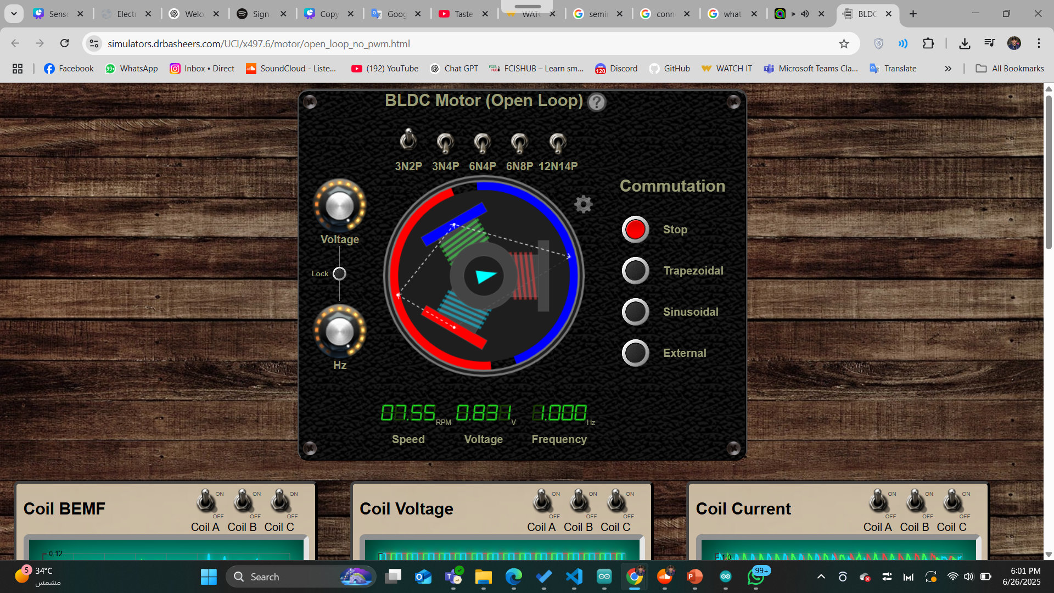
BLDC Motor
https://simulators.drbasheers.com/UCI/x497.6/motor/open_loop_no_pwm.html

Slide 26
How we can Code it?

Slide 27
library we are use it .
#include <Servo.h>

Slide 28
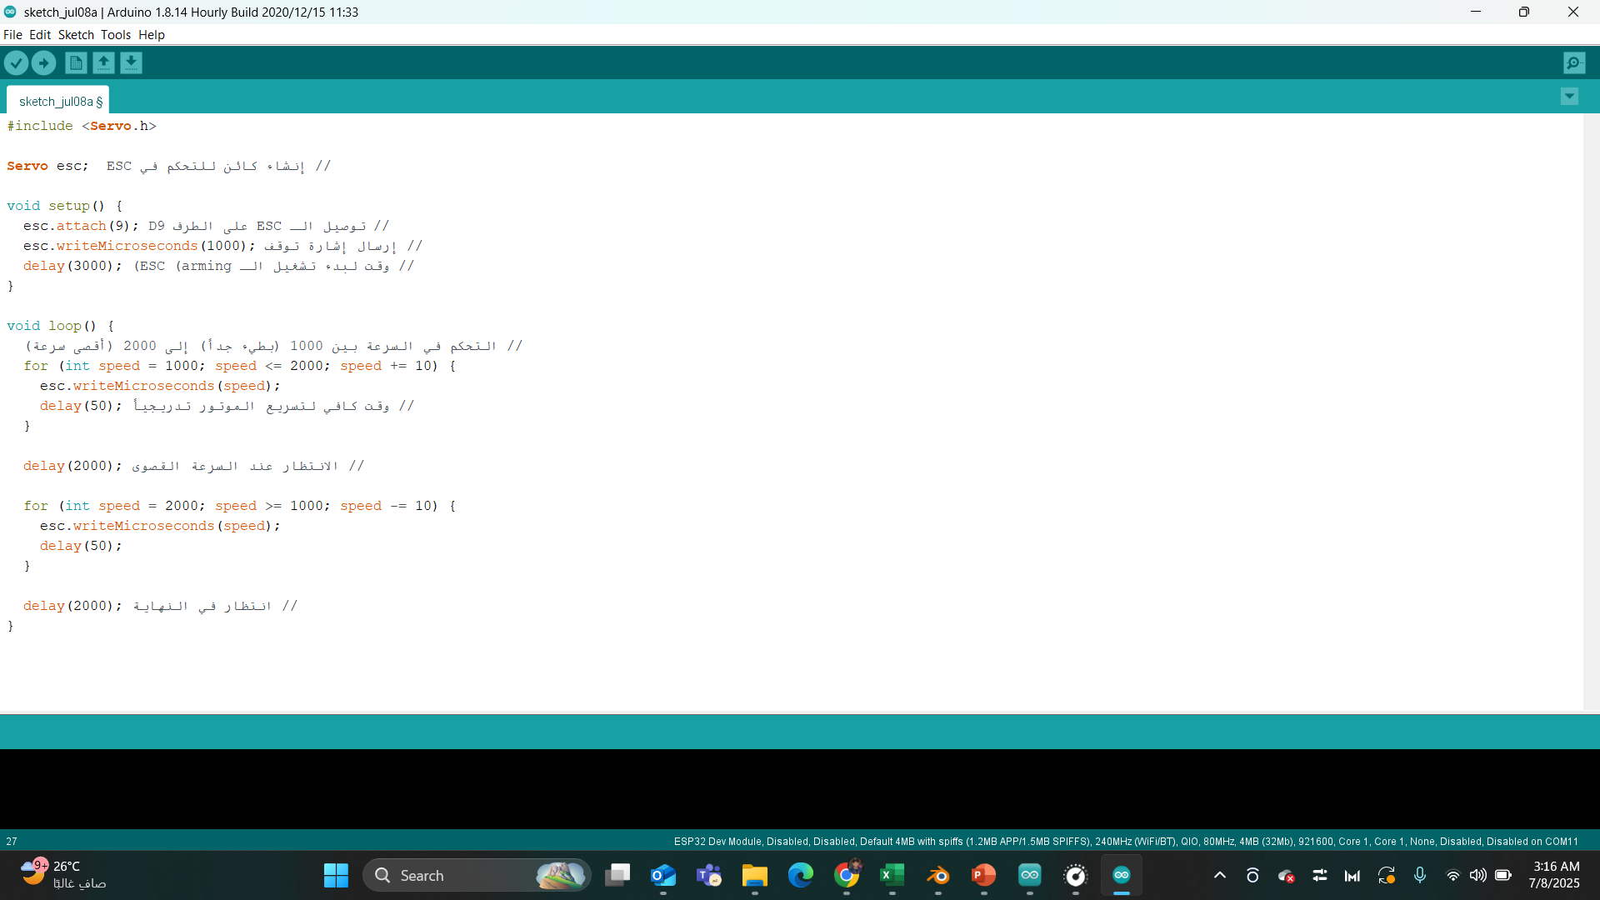
BLDC Code

Slide 29
TASK 2!

Slide 30
Potentiometer

Slide 31
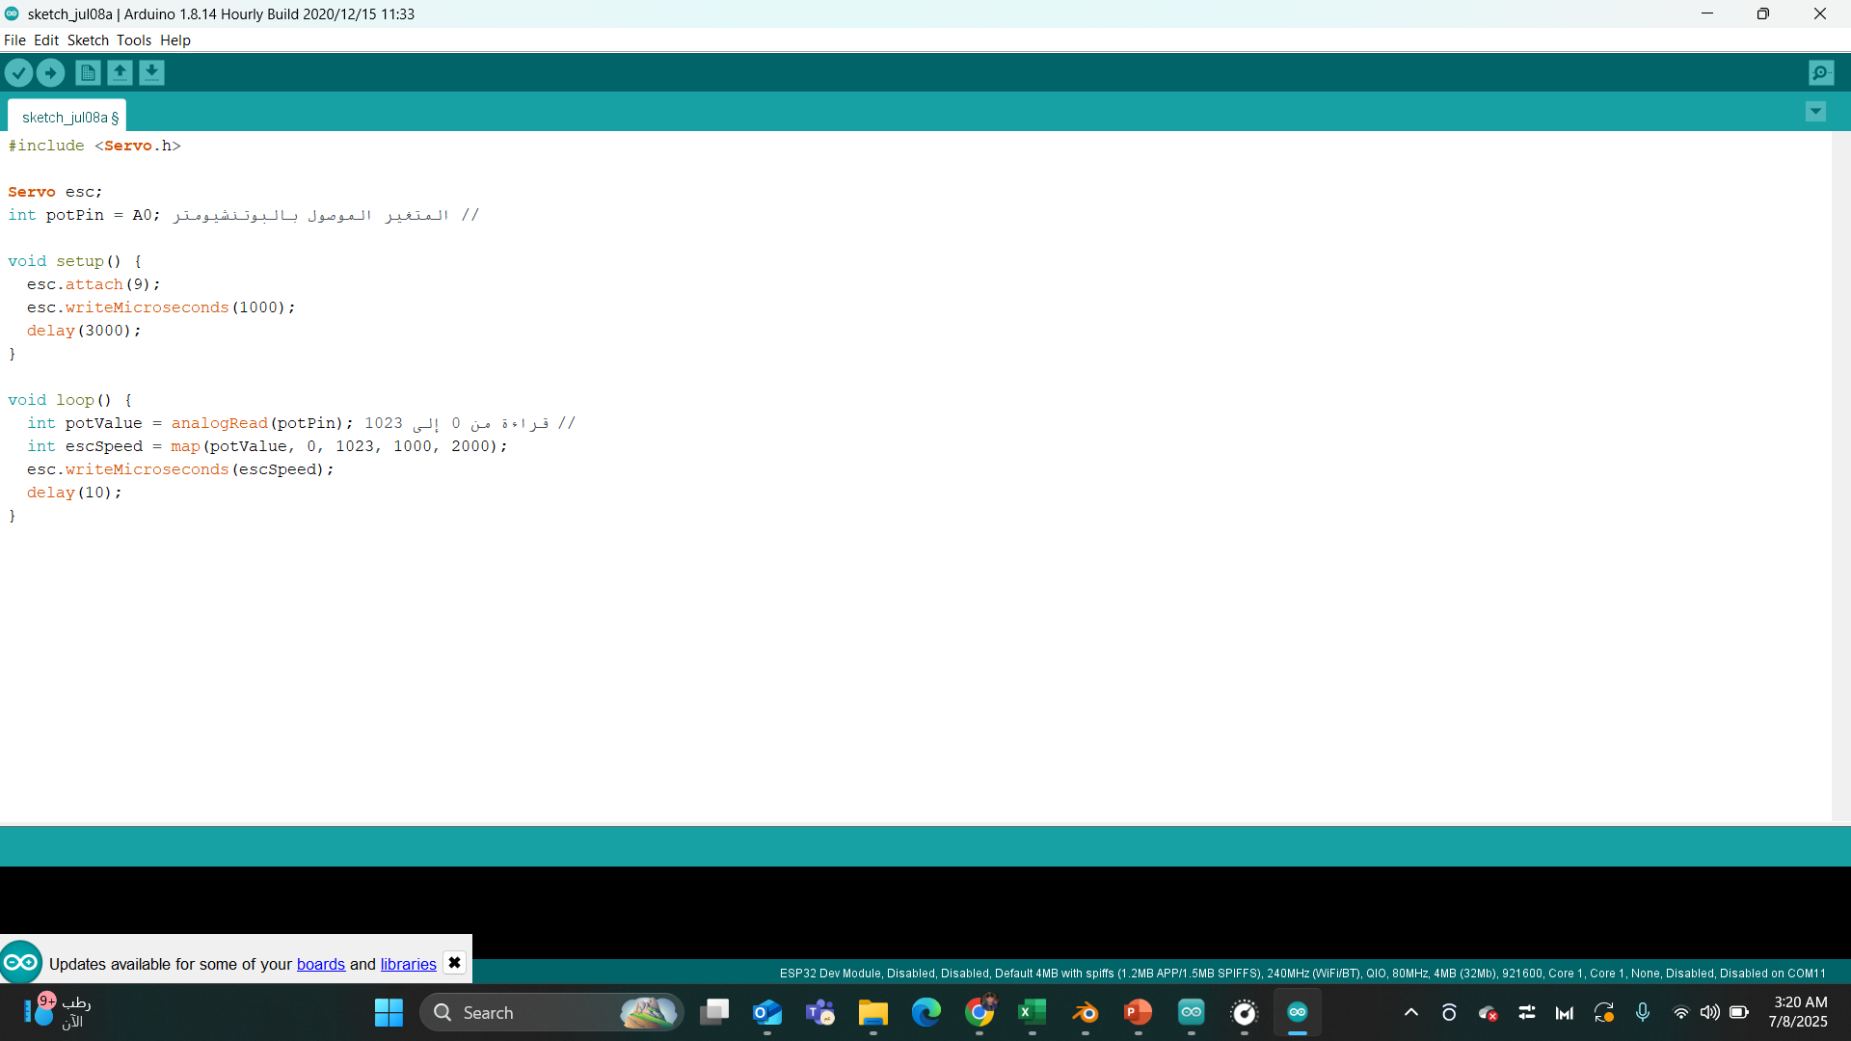
BLDC Code

Slide 32
What’s the deferent between>>
esc.writeMicroseconds(1500);
esc.writeMicroseconds(1600);
esc.writeMicroseconds(1400);

Slide 33
In same ESC have a code to control
esc.writeMicroseconds(1500); >>> Neutral
esc.writeMicroseconds(1600); >>> Forward
esc.writeMicroseconds(1400); >>> Backward

Slide 34
How we can change the direction of motor?

Slide 35
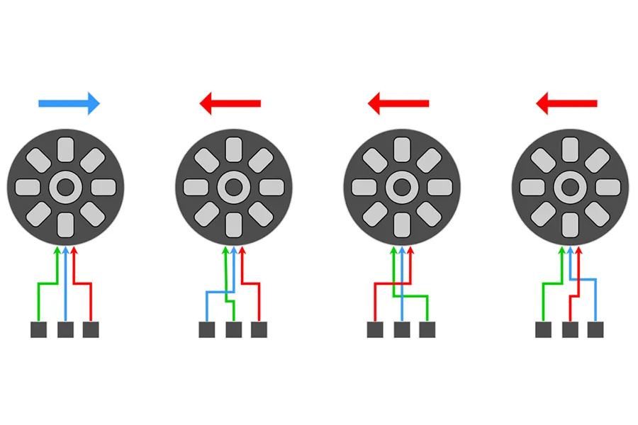

Slide 36
How we can connect ESC with RELAY?

Slide 37
NOTES
we are want 2 relay to change 1 motor direction
relays should be take a data in same time
( acutely from same pin )

Slide 38
TASK 3!

Slide 39
TRY it .
How we can connect ESC with RELAY?

Slide 40

Thank you :)

